Slide 1
Social Network Analysis IS 324
January 16, 2024
Jaihyun Park
jaihyun2@Illinois.edu

Slide 2
Welcome!
Who am I?
Who are you?
What is your name?
What is your major? (Double majoring in any other studies?)
What year are you in?
What do you expect to learn from the class?
What OS is your laptop? (Mac or Windows)
What is your programming background?
What classes have you taken?
Are you familiar with Python?
Beginner, intermediate, or advanced?
What professional experience do you have? (Any internship experience?)

Slide 3
What to expect from the class
Social network theory
Introductory level of Python (Jupyter)
Pandas for reading/loading the data
Regular Expression for extracting nodes
NetworkX for structuring network objects
Matplotlib for visualizing network objects
Network analysis from NetworkX
Assortativity
Clustering
Structural holes
Community detection
GitHub

Slide 4
What I expect from the class
If you don’t have any Python experience,
Don’t be afraid.
Come talk to me if you have any questions, facing any difficulties, or any issues that I can be of help.
If you do have an advanced level of Python experience,
I expect you to actively participate in the class to learn more about network analysis.

Slide 5
What we need for the class
This course does light-weighted coding, so we need a laptop.

Slide 6

Pandas
Pandas loads the structured data into Python.
CSV
HTML
XML
JSON
Pandas DataFrame columns can be accessed through dictionary keys.
Pandas DataFrame values are similar to the list.

Slide 7
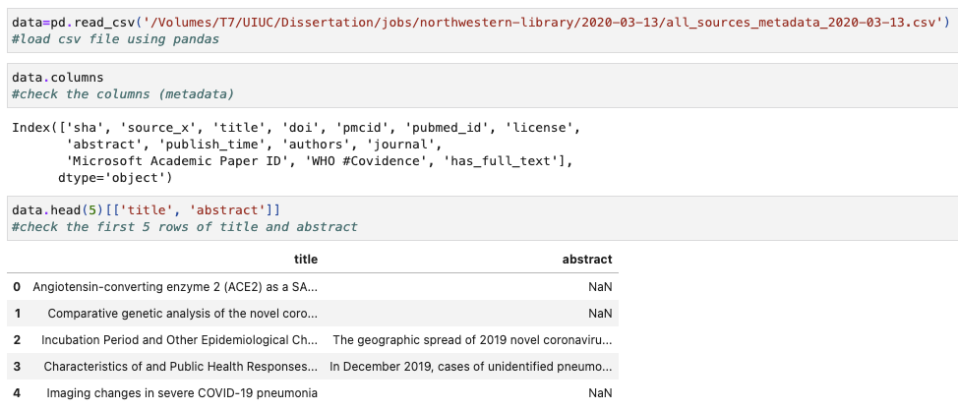
Pandas
https://github.com/allenai/cord19

Slide 8
Regular Expression
Useful when finding the matching string.
Literal characters (Ordinary characters) (e.g., ‘A’, ‘a’ or ‘1’)
Special characters (e.g., ‘.’, ‘$’, or ‘+’)
When we need to identify nodes from social media data
Mention, retweets, or hashtags

Slide 9
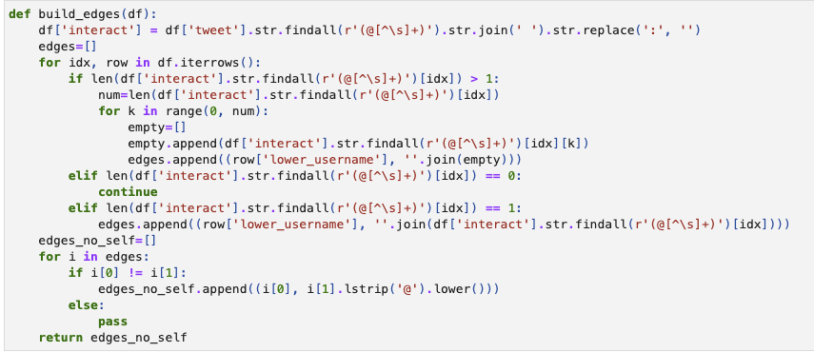
Regular Expression

Slide 10

NetworkX
NetworkX is used to create graph objects.
The graph object can be accessed like a dictionary.
The graph object takes node attributes and edge attributes as a dictionary.

Slide 11
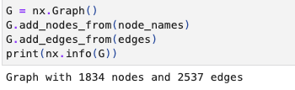

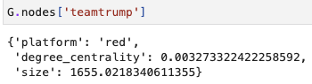
NetworkX
Q: How can we access the value of ‘degree_centrality’ attribute for the node ‘teamtrump’?

Slide 12
Matplotlib
Matplotlib is a visualization library.
Matplotlib supports a wide range of plot types.
Scatter plots
Line plots
Bar plots
Histograms
Pie charts
Matplotlib will serve as a plotting interface for network visualization.

Slide 13
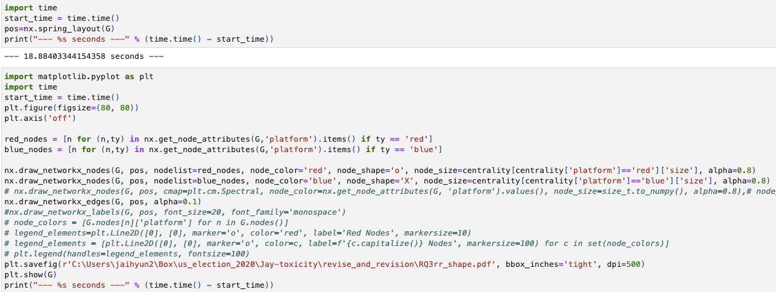
Visualization
Many layouts are available (e.g., Kamada kawai, Bipartite, Spring, Spectral, or Spiral)

Slide 14
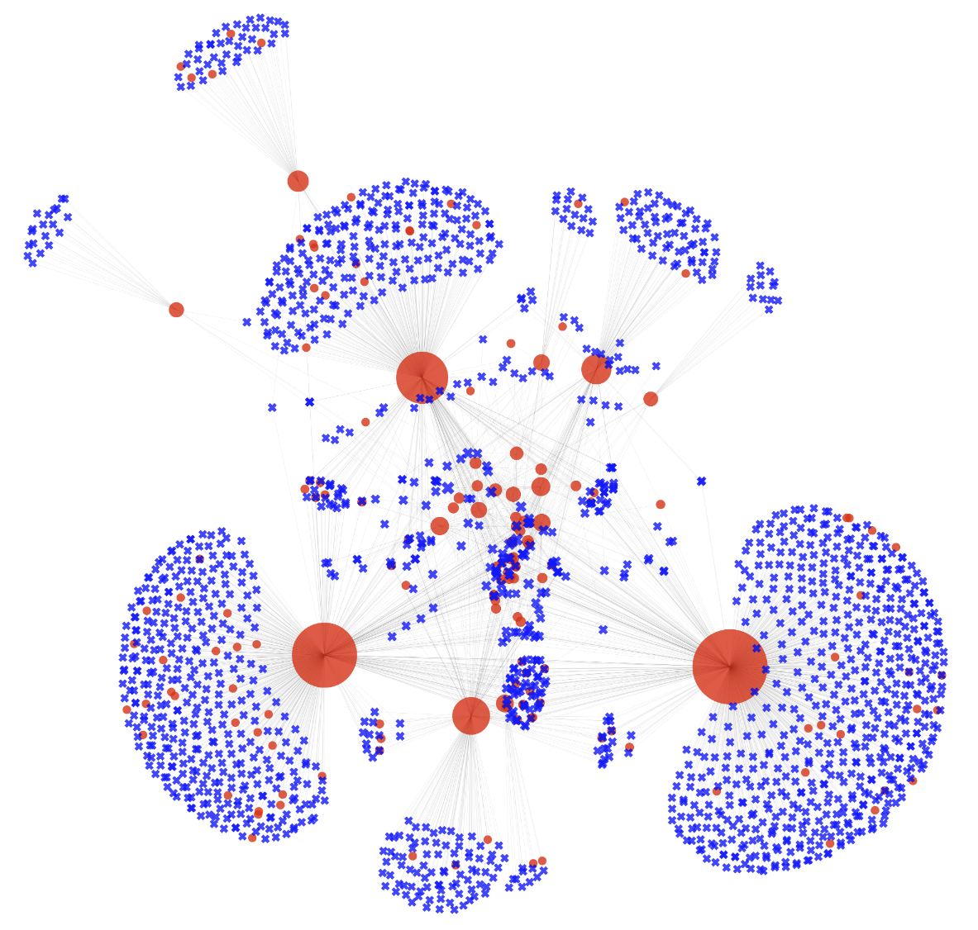
Visualization

Slide 15
The course syllabus is available
https://github.com/park-jay/SP2024-IS324

Slide 16
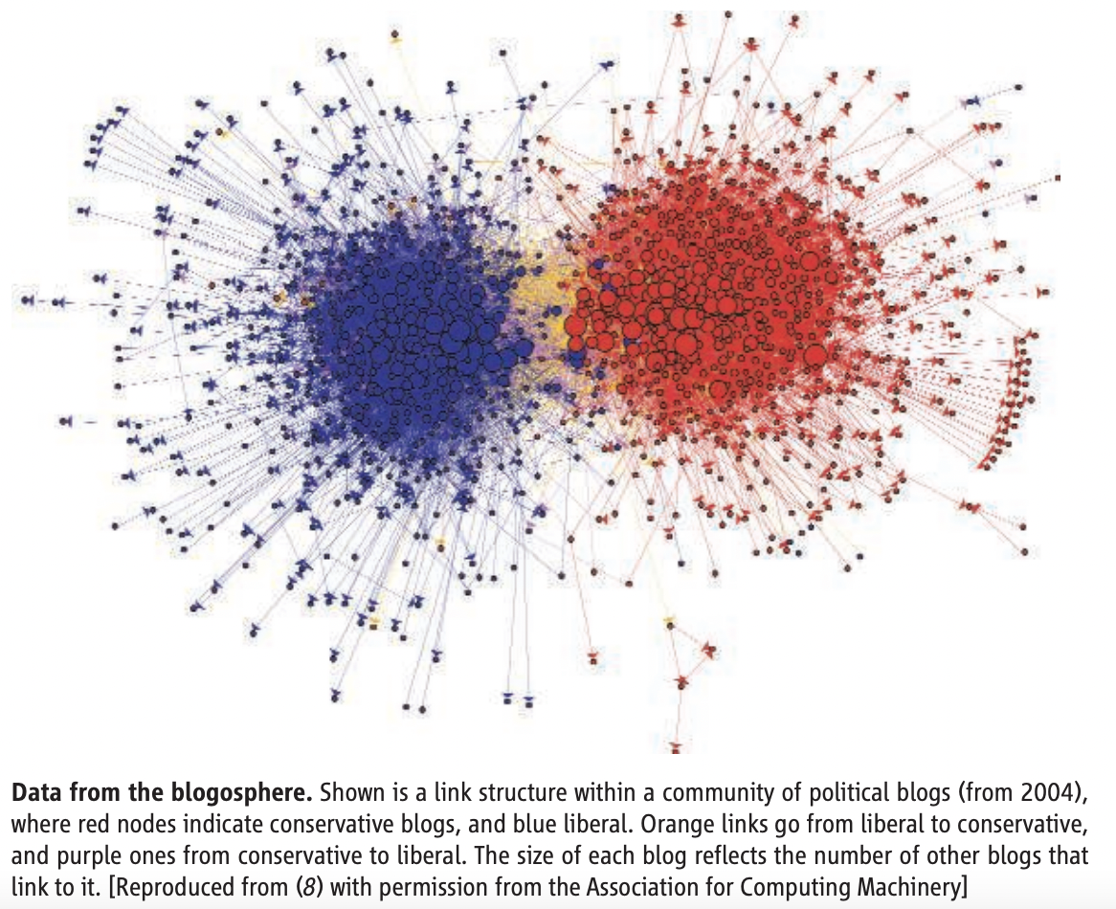
Computational social science
Many social science research can be done using computational approaches = Computational social science
We live life in the network.
What is connecting us?
How do we know we are connected?
What do we learn from social networks?
Lazer et al., 2009

Slide 17
Computational social science
Group Discussion (2-3 ppl)
What is connecting us?
How do we know we are connected?
What do we learn from social networks?

Slide 18
Computational social science
Our life is full of networks.
We check emails, message friends, make phone calls, check out books from libraries, and make purchases with credit cards.
We also use social media to get in touch with friends.
It has become an important component of living.
Imagine how often we open Snapchat, Instagram, or YouTube.
Imagine how lonely we will be if we are disconnected from family and friends.
Humans are social being: Emotional support + Entertaining

Slide 19
Computational social science
What is connecting us? : Real-life network
Family
Hobby
Friends
Co-workers, or mentor-mentee
Neighbors
What is connecting us? : Virtual/Online network
Social media
Online games
The lines between real-life network and online network have become blurry.

Slide 20
Computational social science
How do we know we are connected? : Real-life
What is being connected?
Entities (e.g., Humans, companies, or geographic locations)
How are they connected?
Relations (e.g., friends, co-workers, or neighbors)
How do we know we are connected? : Virtual/Online
What is being connected?
Entities
How are they connected?
Relations

Slide 21
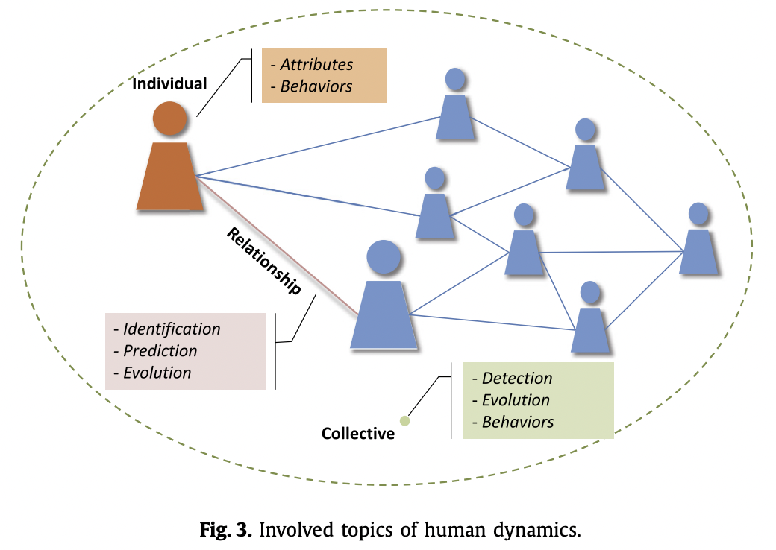
Computational social science
What do we learn from social network?
Zhang et al. 2020
Notes:
Individual-level VS. macro-level

Slide 22
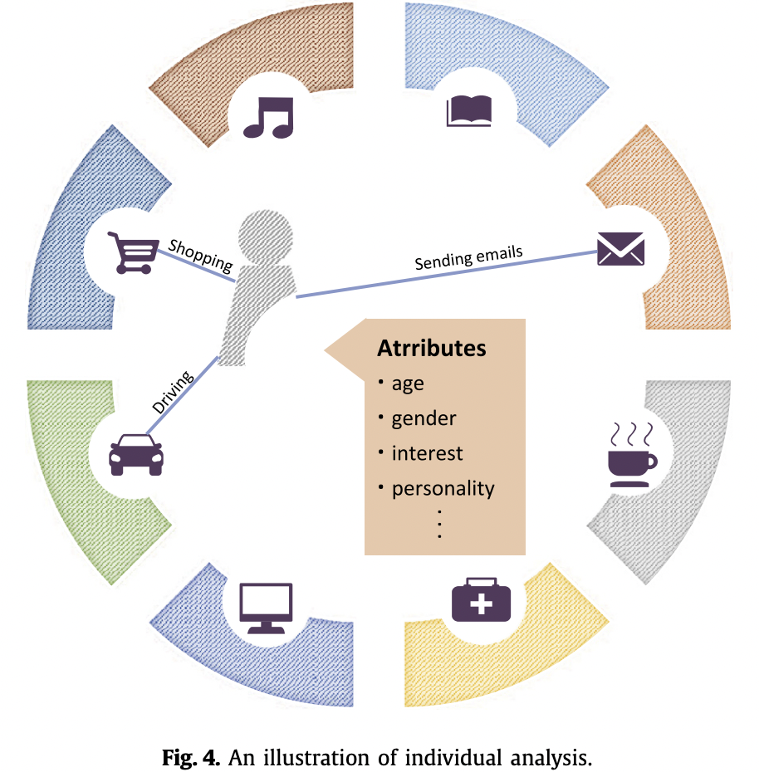
Computational social science
Zhang et al. 2020

Slide 23
Computational social science
What is opportunity?

